Slide 1


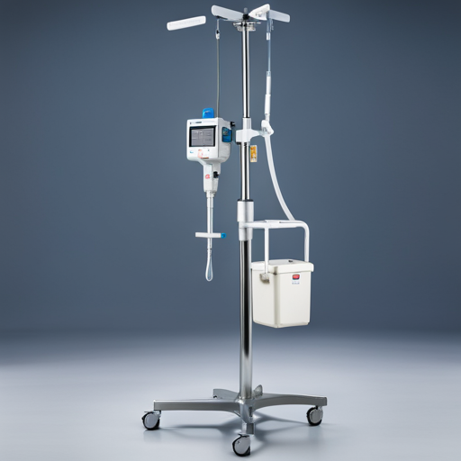

GROUP 1
Portable IV Stand with Rate Monitoring
PROJECT PROPOSAL

Slide 2



Objectives
Introduction:
The proposed project aims to address a critical issue in healthcare settings, where the need for precise medication administration through intravenous (IV) therapy often clashes with the limitations of existing IV stands.
Current IV stands lack the capability to monitor and control the drip rate accurately, necessitating constant oversight from medical staff. This deficiency can lead to medication errors, compromising patient safety and healthcare efficiency.
The problems faced are:
Blood Loss: Blood starts to flow from the body towards the bottle because of pressure difference.
Air Bubbles: It can be of fatal risk of air bubbles entering the patient’s bloodstream, which is a severe threat as air bubbles in the blood can be fatal.
Discharge quantity: It is also a critical factor that depends on the medicine being administered. Typical infusion sets allow a user to manually adjust the fluid flow delivery rate by visually inspecting individual drops of the liquid falling within a drip chamber and adjusting a roller clamp accordingly.
Skilled Labour Requirement: To successfully adjust the infusion rate, and monitoring & replacing fluid container at right time calls for well-trained health care assistant, as it is in Indian context, completely depends on the judgment and skills of the health care assistant.

Slide 3
Objectives
Market Research:
More than 90% of hospitalised patients receive some form of IV therapy. Unfortunately, about 1/5 of these patients experience IV complications due to lack of administration care and adequate monitoring.
During the medication administration process, errors occurred in about 30% of IV medication administration.
In the US, medical errors cost the lives of up to 251,000 people annually,2 and each year, the overall cost of caring for patients after medical errors is $20 billion.
According to the National Reporting and Learning Service, (4 ) the rates of medication administration errors (MAEs) are still unacceptably high.
MAEs with IV medications have a higher risk of significant adverse effects than any other administration route because the IV route leads to near-instant absorption and dispersion into the blood stream.Approximately 10% of MAEs were found to be IV-related, and 57.9% of the reported IV infusion-related errors were related to “wrong rate.”
( Reference Link )

Slide 4

Objectives
User Requirements:
The target users, including nurses and doctors, have specific requirements and expectations:
Accurate Medication Delivery: Users demand a solution that guarantees precise medication administration, reducing the risk of adverse events.
Ease of Use: The IV stand should be user-friendly, allowing medical staff to adjust and monitor drip rates effortlessly.
Safety: Users require a system that provides alerts and alarms at critical levels to prevent under- or over-medication.
Modularity: A modular design is essential to adapt to varying clinical needs and ensure ease of maintenance.
Cost Effective: An affordable solution is required so that can be practically implemented in Indian hospitals.

Slide 5
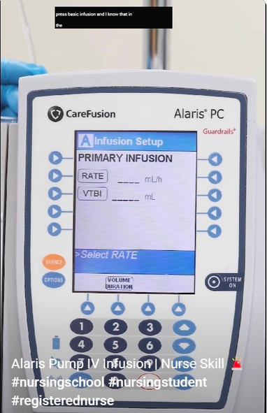
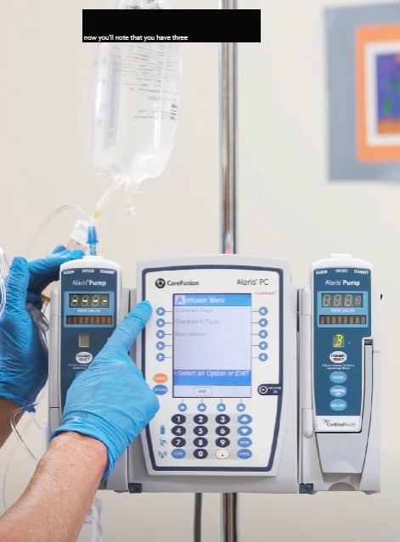
Competitive Analysis
1. Smart Pump IV stand
In 2018, 89.5% of hospitals in the United States used smart pump technology according to a survey.
Drip flow rate and Volume to be given can be set.
Has a database with patient’s profile, where it stores data and can be used directly in future for the same profile.
Has alarm system,to give an alert at the end of the medicine volume.
Demerits:
Infusion errors
Alarm fatigue: The Joint Commission in the United States, have recognized alarm fatigue as a significant issue.
Programming errors such as entry of wrong drug, wrong rate, wrong concentration or wrong weight, and varying levels of trust in smart pumps by nurses who use them.

Slide 6
Future Innovations
Lighter and Smaller Design: increase portability and improve patient mobility.
Battery-Powered Options: efficient and long-lasting battery ensuring uninterrupted therapy even during power outages or when patients need to change positions.
Real-Time Alerts: transmit real-time alerts and notifications to healthcare providers' devices or central monitoring stations. This ensures immediate responses to alarms and issues, contributing to patient safety.
This presents an opportunity for innovation and product differentiation. By offering an affordable, reliable, and technologically advanced solution, we aim to address this gap and gain a competitive edge.

Slide 7
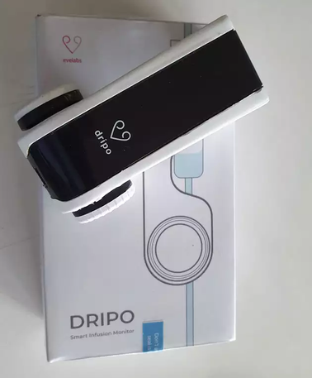
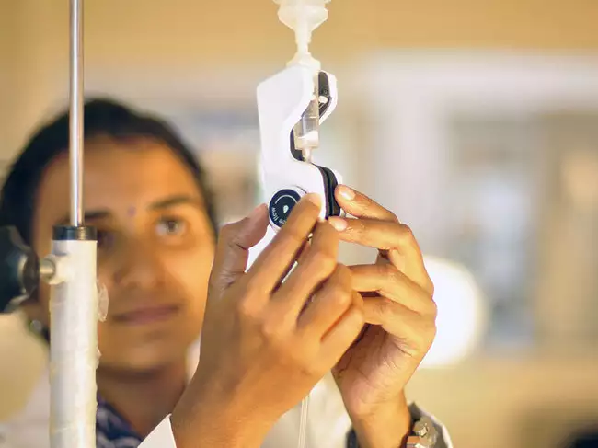
Competitive Analysis
2. Dripo (Evelabs Technologies)
A product made by a student of NID in 2019 and now is produced by their start-up Evelabs Technologies.
It can regulate and monitor IV drip flow rates.
The smart device gives an alert to the nurse when there is a rate change, completion or block in the IV.
The product comes in two variants - standalone and WiFi enabled.
Currently is not so popular.
They claim to have served more than 90 plus customers with 3500 units in the field spanning Multi Speciality Hospitals, Clinics, and Govt Hospitals with a customer base in all Indian states and southeast asia.

Slide 8

PRODUCT DEVELOPMENT

Slide 9
Initial Conceptualisation
Functionalities to Incorporate:
First in place:
Drip Flow Rate Measurement and Display: To measure and display the flow rate at which the medicine is going through the IV drip to the patient’s body.
Percentage of Dose Left: To keep a check on the amount of the dose left in the IV bottle.
If time permits
Alarming and Notifying system: To notify and display the nurse/doctor of the situation continuously and alert them at the critical situations, like end of the dose.

Slide 10
Implementation
Drip Flow Rate Measurement and Display:
Use of Infrared sensor: To get the drop count/sec
The IR transmitter emits IR light and the IR receiver on the other end receives the signal. Any medium in between will refract the light and thus will deflect it from reaching the receiver, which generates a pulse
Percentage of Dose Left:
Use of Load cell:
The load cell measures the weight of the medicine continuously. This helps in determining the percentage of dose left in reference to the initial weight as 100% dose.
Use of LED lights:
We’ll use 3 LED light, Green, Yellow and Red, according to the peercentage of dose left. The red light represents an alerting situation and need to replace the IV bottle.

Slide 11
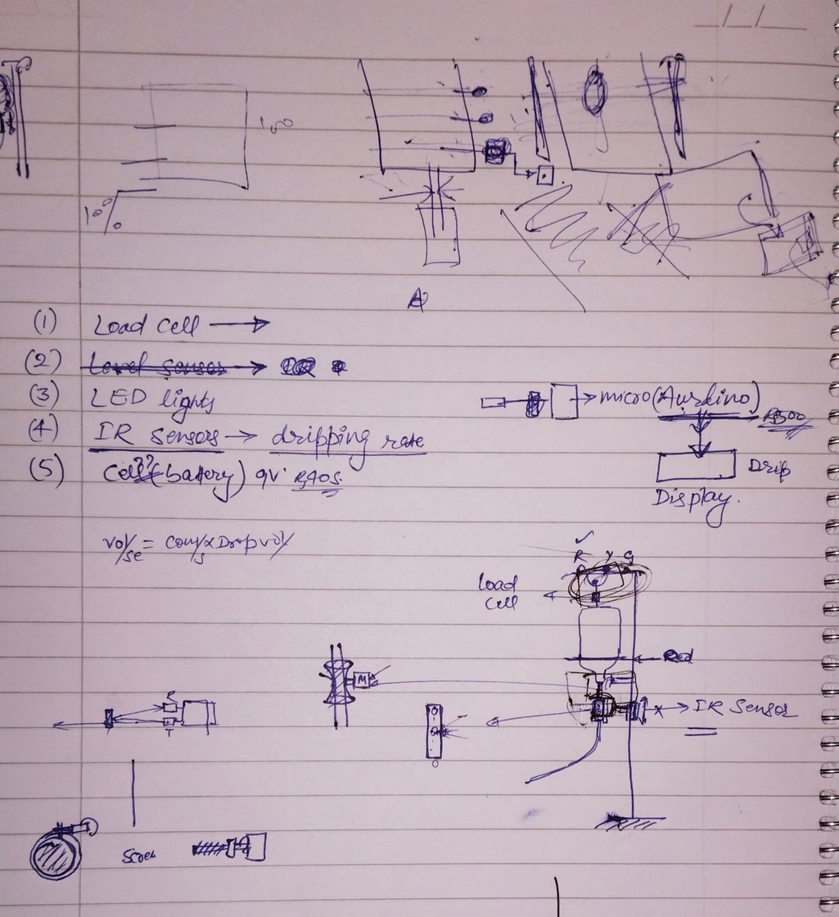
Brainstorming

Slide 12
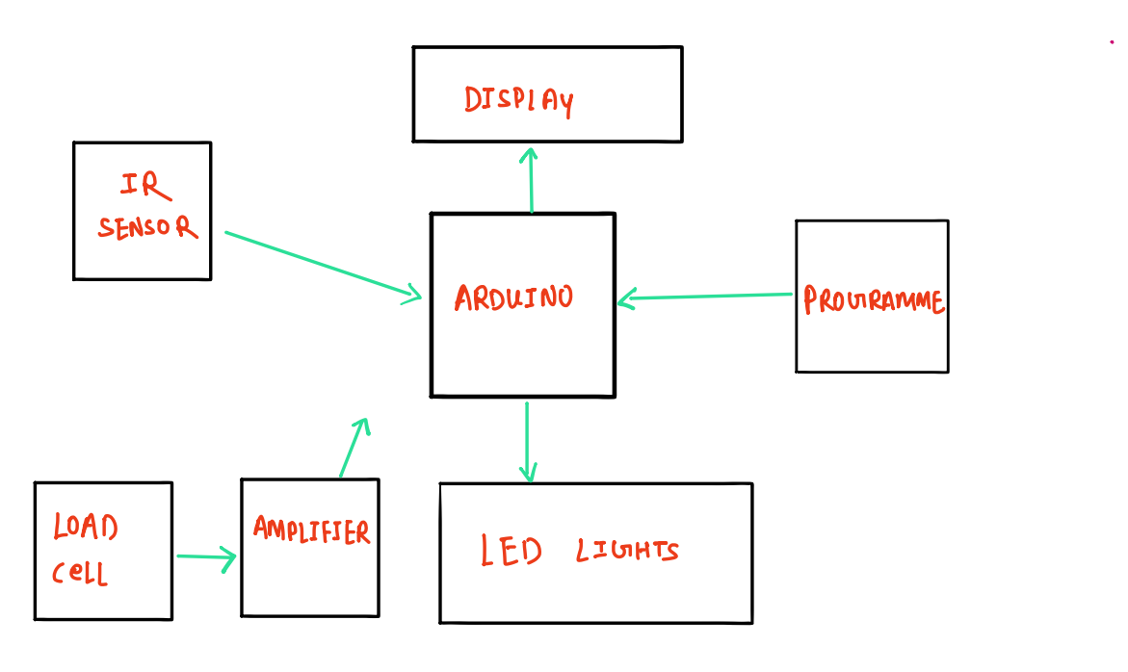

Slide 13
Required Components:
IR sensor - Rs.700
Load Cell Sensor + Load cell Amplifier - Rs. 600
Arduino - Rs. 800
Batteries(5V) - Rs.600
Breadboard +Jumper wires - Rs. 240
LED lights
Total under Rs.5000

Slide 14
PROGRESS
REPORT

Slide 15
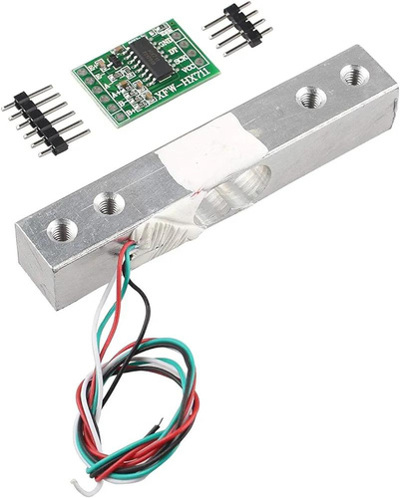
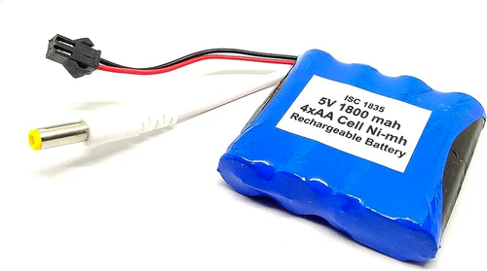
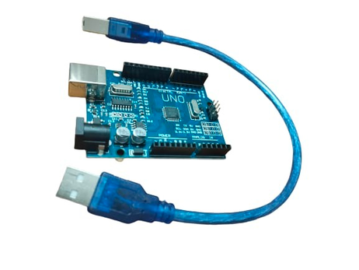
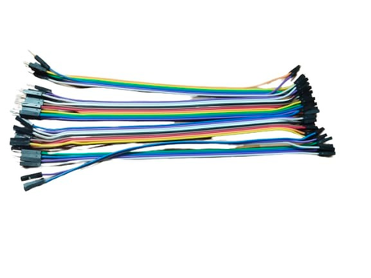
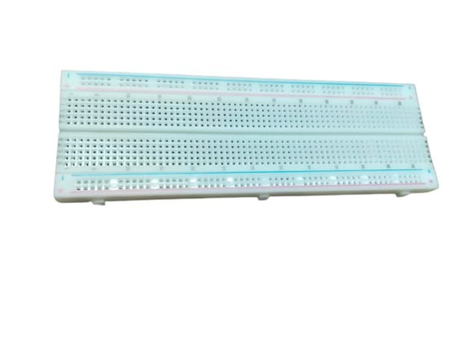
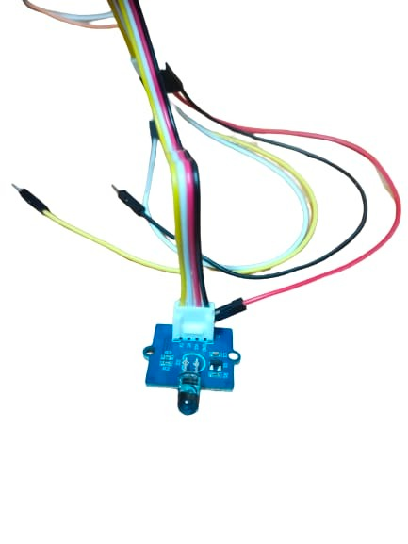
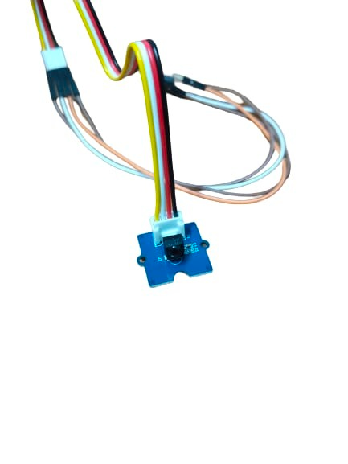
Components
LOAD CELL & HX711 AMPLIFIER
5V BATTERY
ARDUINO UNO
IR EMITTER & IR RECIEVER
JUMPER WIRES
BREADBOARD

Slide 16


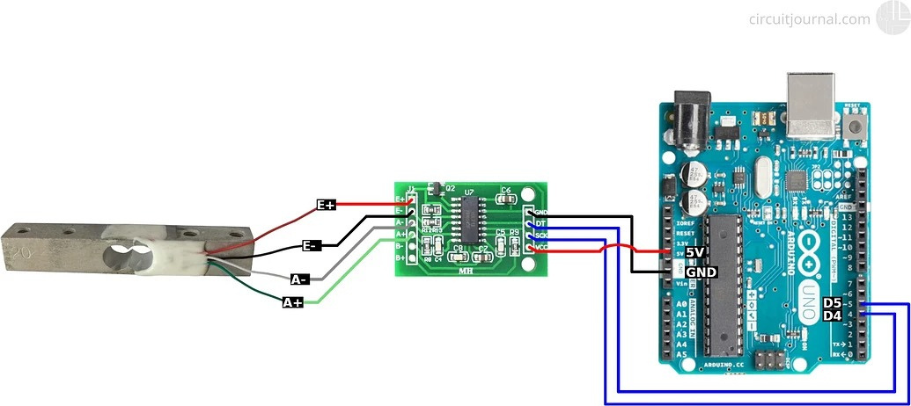
Load Cell Circuit Diagram
Everest Cantu
Drew Holloway
Morgan Maxwell
Manager
Marketing
Business Head
Manager
Load cell
HX711 Amplifier
Arduino

Slide 17
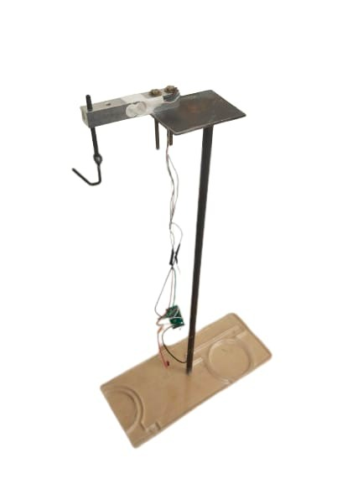
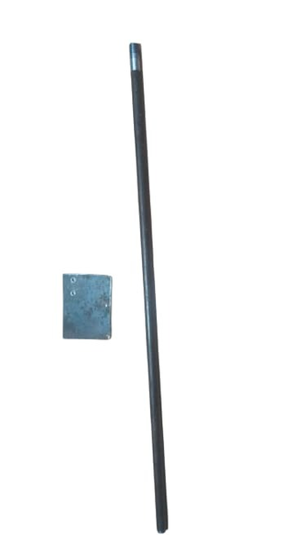
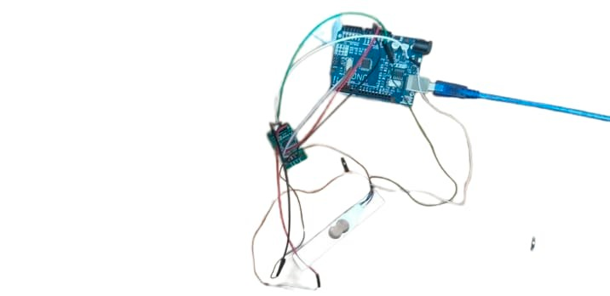
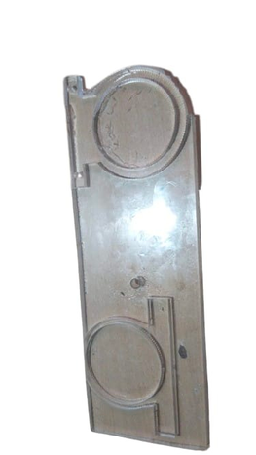
IV Stand & Assembly
Load Cell
Components used for making IV stand
Load cell circuit attached to IV stand
IV stand with load cell fixed to it and has a hook for carrying weight

Slide 18
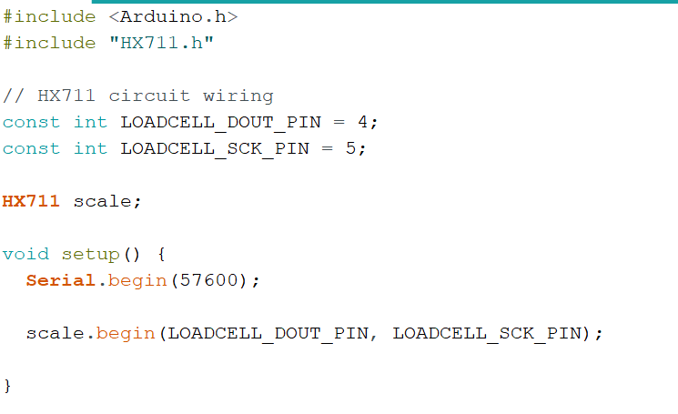

Load cell Calibration Code

Slide 19
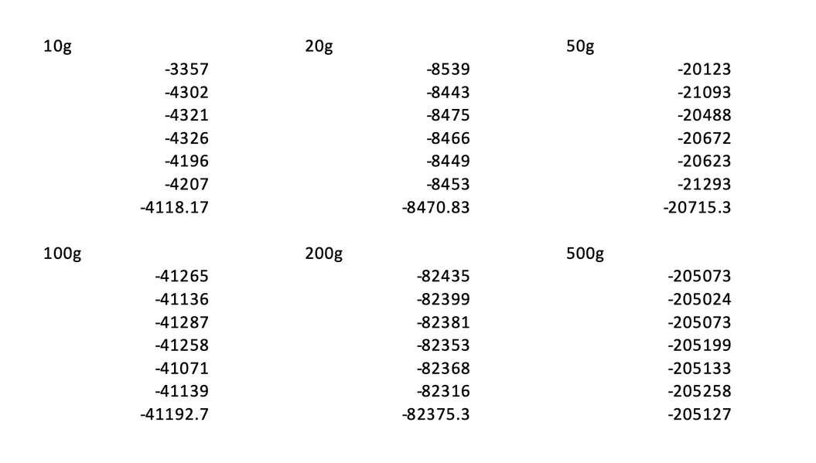
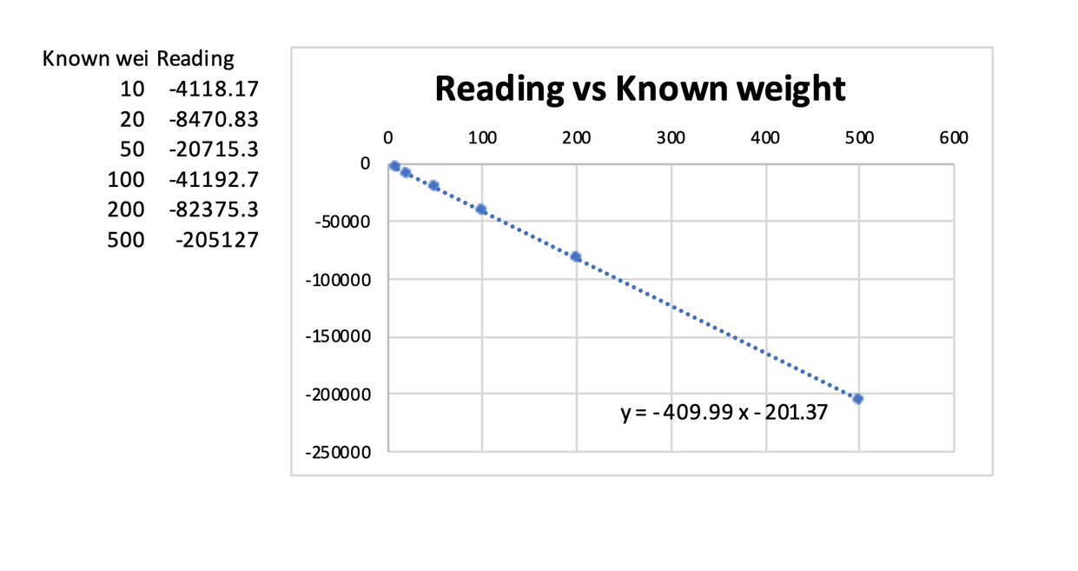
Load cell Calibration
CALIBRATION FACTOR = -499.99

Slide 20
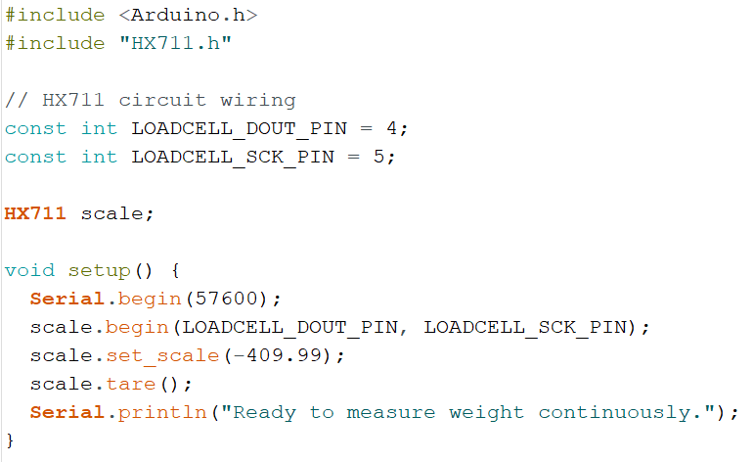
Weight measuring Code

Slide 21
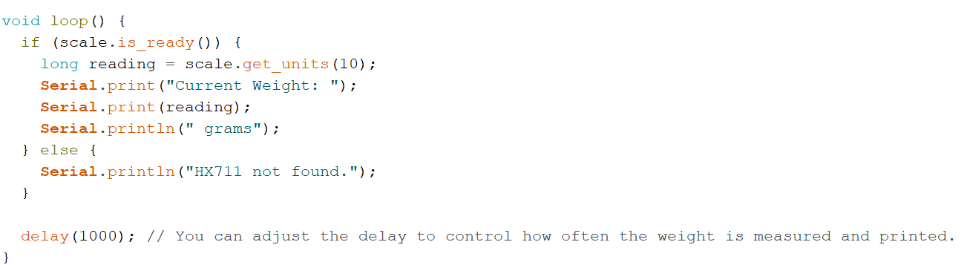
Weight measuring Code

Slide 22

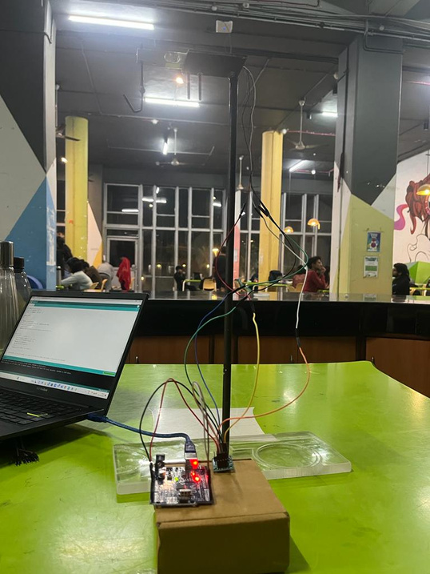
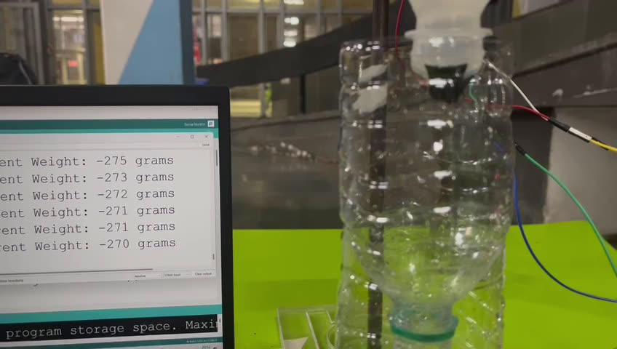
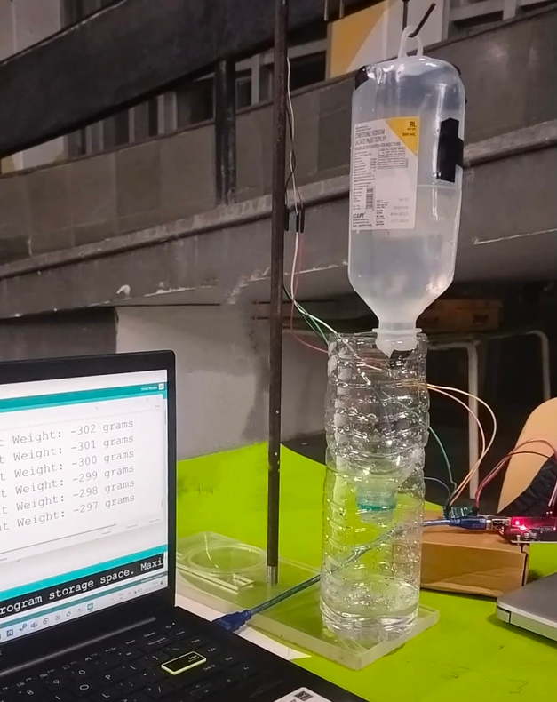
WORKING

Slide 23
FINAL
REPORT

Slide 24
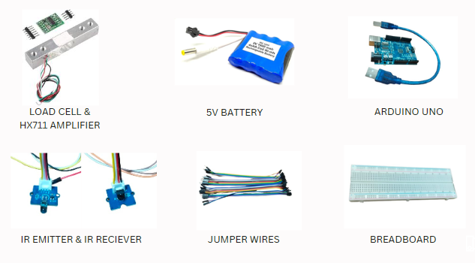
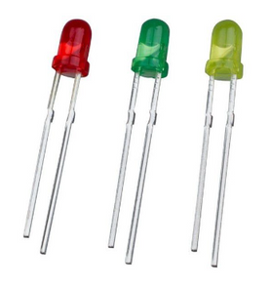
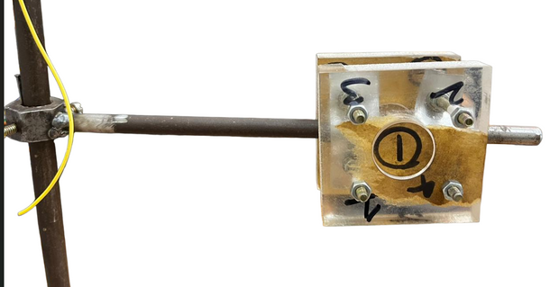
IV stand components:
LED lights
IR sensors holder

Slide 25
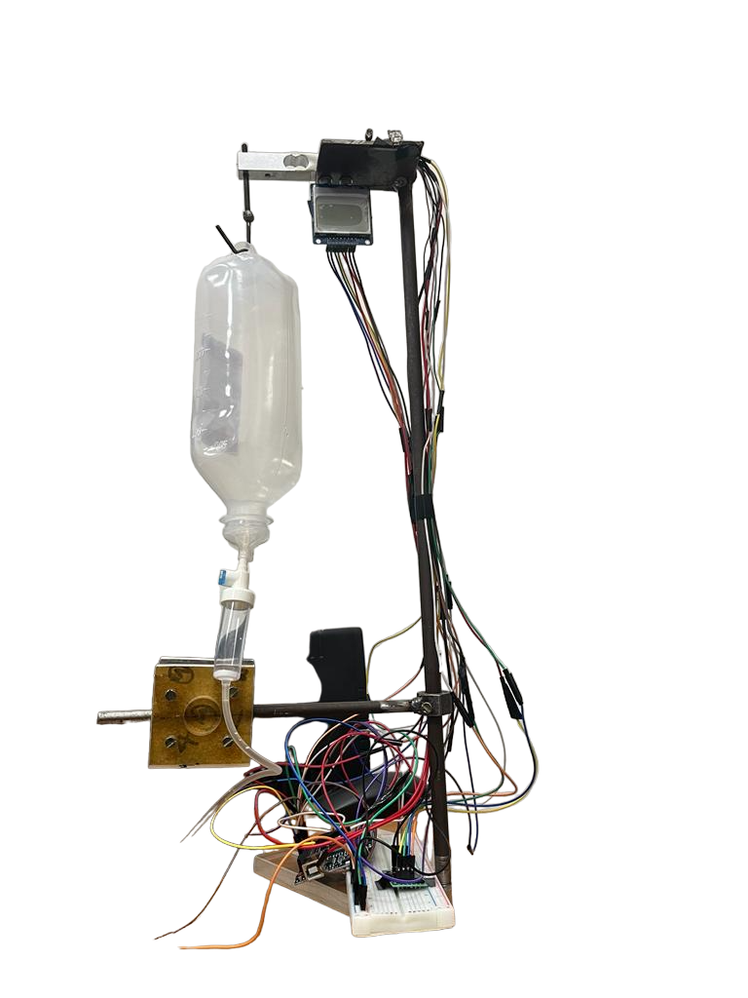
Final Assembly

Slide 26

Code

Slide 27
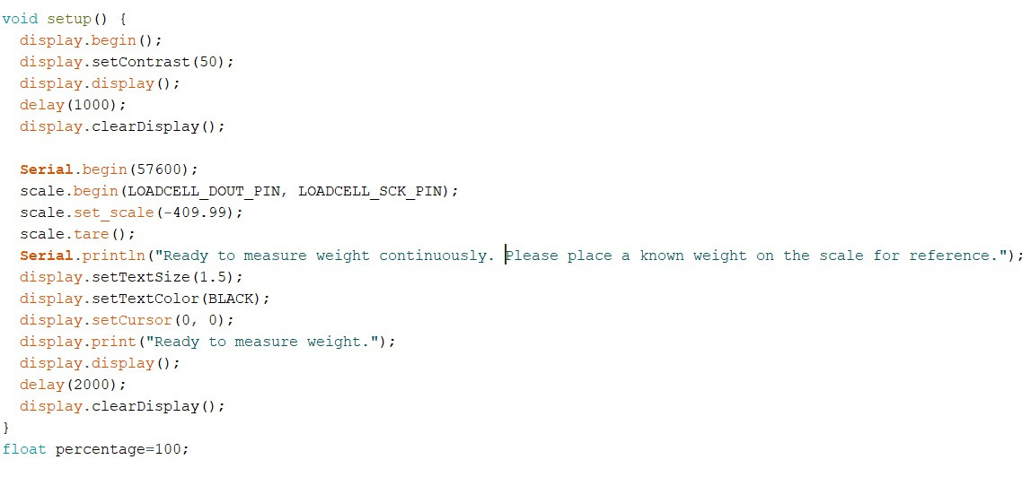

Code

Slide 28


Code

Slide 29
Code

Slide 30

Code

Slide 31
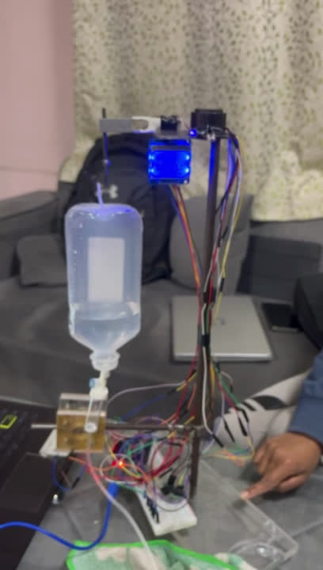
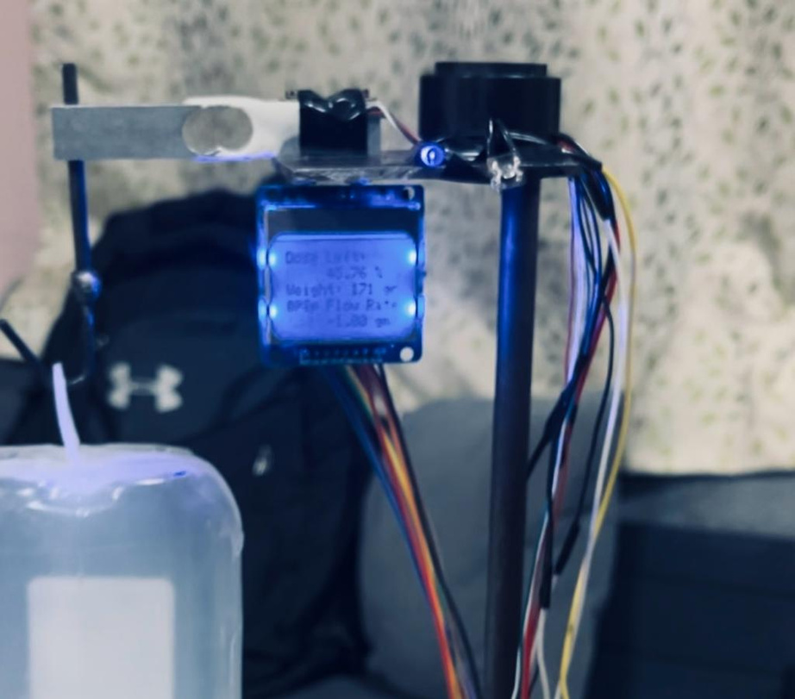
SAFE ZONE
Volume of liquid >20%

Slide 32
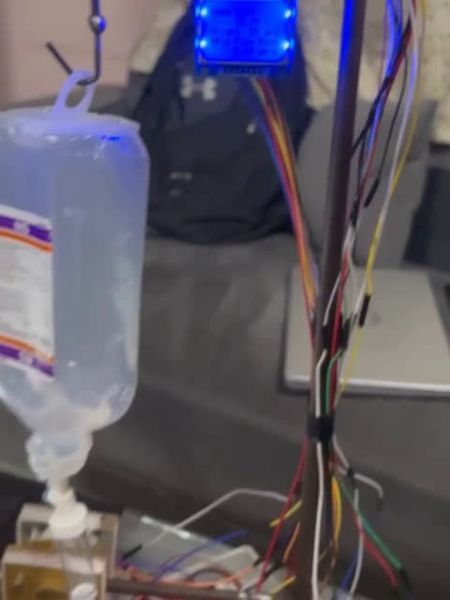
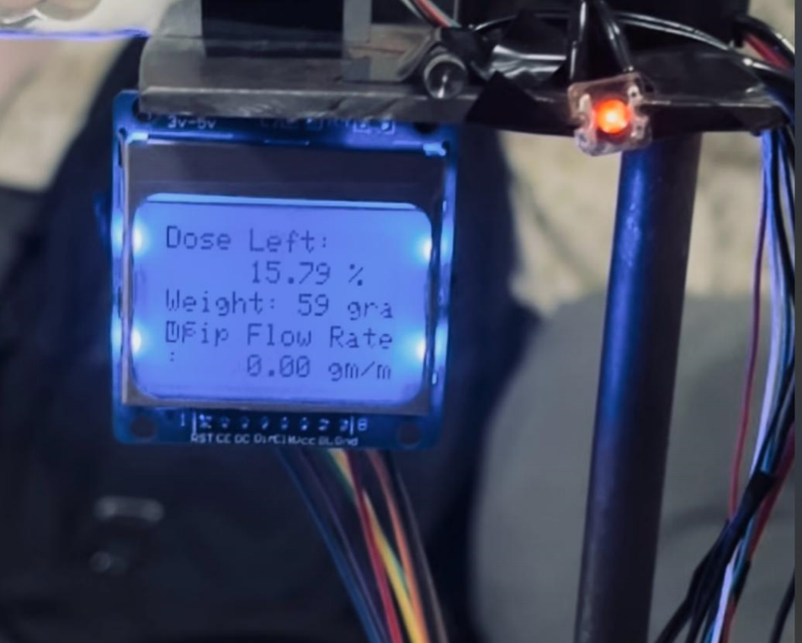
RED ZONE
volume <=20%

Slide 33
THANK YOU
Sweta Kumari [2021AM10206]
Priyanshi Tayal [2021AM10999]
S B Amlan Das [2021AM10780]
Ritik [2021AM10800]

